Slide 1


Car Price Prediction
A Detailed Machine Learning Workflow
A comprehensive, step-by-step walkthrough of building a supervised regression model to estimate car prices from technical specifications and physical attributes — from raw data to deployment-ready predictions.
SUPERVISED LEARNING
REGRESSION
PYTHON · SCIKIT-LEARN
Presented by :- Bhavit Gupta
Vansh
Aman

Slide 2
Understanding the Problem Statement
Before writing a single line of code, it is essential to clearly define what we are solving, why it matters, and how to frame it within the machine learning landscape. A well-scoped problem statement guides every downstream decision — from data collection to model selection.
The Goal
The ML Task: Supervised Regression
Build a predictive model that can accurately estimate the price of a car based on its technical specifications and physical attributes — including engine size, horsepower, fuel type, body style, wheelbase, and more.
This is a Supervised Learning task because we are training on labeled historical data — each car in our dataset has a known price. It is specifically a Regression problem because the target variable (price) is a continuous numerical value, not a discrete class.
Why It Matters
Input (X)
Output (y)
Accurate price estimation empowers car manufacturers to set competitive MSRP values, helps dealerships optimize inventory pricing, and enables buyers to assess whether a listed price is fair. It also surfaces which features drive value in the market.
26 car attributes: engine specs, dimensions, fuel type, body style, drivetrain
A single continuous value: the estimated market price of the car

Slide 3
Data Collection & Environment Setup
A strong model starts with strong data. Our dataset contains real-world information on over 200 car models, capturing a rich set of attributes that influence market price. Before any analysis, we assemble the Python toolchain that will power every stage of this workflow.
Dataset Overview
The Python ML Stack
200+ Car Models
26 Features
Pandas
Real-world dataset spanning multiple manufacturers, body styles, and market segments
Engine size, horsepower, fuel type, car body, wheelbase, curb weight, and more
Data manipulation, loading CSVs, filtering, grouping, and transforming tabular data. The backbone of data preparation.
NumPy
Target: Price
Efficient numerical computations, array operations, and mathematical functions underpinning all ML algorithms.
Continuous numerical variable representing the car's market price
Matplotlib & Seaborn
The dataset is loaded from CarPrice_Assignment.csv into a Pandas DataFrame. A quick df.head() snapshot reveals column names, data types, and initial value ranges — the first step in understanding what we're working with.
Visualization libraries for EDA — histograms, heatmaps, box plots, and scatter plots that reveal data patterns.
Scikit-Learn
The gold-standard library for model training, evaluation metrics, train-test splitting, and preprocessing pipelines.

Slide 4
Data Integrity: Duplicates, Nulls & Errors
Raw data is rarely clean. Before any modeling, we must audit the dataset for issues that could silently corrupt our results. Three categories of data quality problems must be identified and resolved: duplicate entries, missing values, and logical inconsistencies.
🔍 Duplicate Detection
🕳️ Null Value Audit
⚠️ Logical Error Scanning
Duplicate rows artificially inflate the weight of certain observations, biasing the model toward overrepresented samples. We check with df.duplicated().sum() and remove duplicates using df.drop_duplicates(). Even a small number of duplicates can skew regression coefficients and inflate performance metrics on training data.
Missing values (NaN) must be identified with df.isnull().sum() and handled strategically. Options include: removing rows with excessive missingness, imputing with column means/medians for numerical features, or using the most frequent category for categorical features. The chosen strategy depends on the volume and pattern of missingness — random vs. systematic.
Beyond missing data, we scan for values that are technically present but logically impossible — such as negative prices, zero engine sizes, or horsepower values outside realistic ranges. These outliers can dramatically distort model training. Domain knowledge is critical here: a 5000 cc engine is plausible; a −50 cc engine is not.

Slide 5
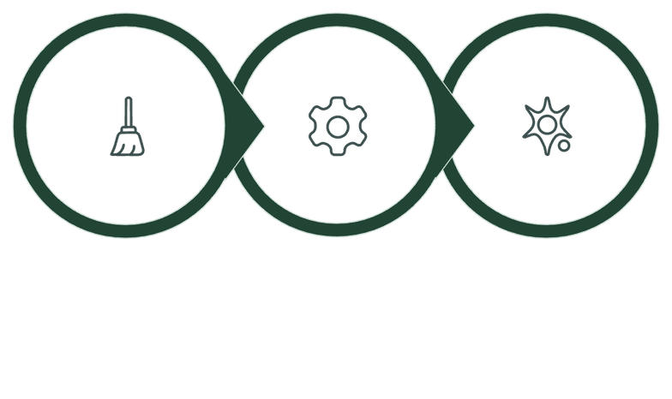
Data Cleaning & Feature Engineering
Once data quality issues are resolved, we move to feature engineering — the art of shaping raw attributes into inputs that help the model learn more effectively. This phase removes noise, corrects data types, and prepares the feature space for encoding and modeling.
Column Removal
Format Correction & Type Casting
Not all columns in a dataset are useful for prediction. The car_ID column, for example, is a unique identifier with no predictive power — every value is distinct, so it cannot generalize to new data. Including such columns introduces noise and can cause overfitting. We drop these with df.drop(['car_ID'], axis=1).
Before encoding categorical variables, we ensure all such columns are properly typed as object or category in Pandas. Sometimes numeric-looking columns (e.g., a "0/1" flag stored as int) are actually categorical and should be recast. Conversely, columns stored as objects that contain numeric data (e.g., "1200" stored as a string) must be converted to integers or floats.
Other candidates for removal may include columns with near-zero variance (almost all values are the same) or columns that leak future information not available at prediction time.
Feature Engineering Opportunities
Ratios: Horsepower-to-weight ratio as a proxy for performance
Binning: Grouping engine sizes into "small," "medium," "large" categories
Interactions: Combining fuel type with aspiration (turbo vs. standard)
Derived features: Age of car model if a year column exists
Clean
Engineer
Encode
This three-phase pipeline ensures the dataset transitions cleanly from raw and messy to structured and model-ready. Each step builds on the previous one — skipping or rushing any phase introduces risk downstream.

Slide 6
Exploratory Data Analysis: Visualization
EDA is where the data tells its story. Before modeling, we use visualizations to understand distributions, detect patterns, identify correlations, and spot anomalies. This phase directly informs feature selection, transformation decisions, and model expectations.
📊 Distribution Plot: Understanding Price
🔥 Correlation Heatmap: Feature Relationships
A distribution plot (histogram or KDE plot) of the target variable price reveals whether the data is normally distributed, skewed, or multi-modal. In car pricing datasets, price is typically right-skewed — most cars cluster in the affordable range, with a long tail of luxury and exotic vehicles pulling the mean upward. This insight is critical: a skewed target may benefit from a log transformation before regression, improving model fit and residual normality.
A heatmap of the correlation matrix reveals which features are most strongly associated with price — and which features are correlated with each other (multicollinearity). In car datasets, engine size and horsepower typically show strong positive correlations with price. Meanwhile, engine size and horsepower are also highly correlated with each other, which may require dimensionality reduction or careful feature selection to avoid inflating variance in linear models.
Key Questions Answered
Typical Strong Correlations
Are most cars affordable or high-end? Is there a natural price segmentation? Are there outliers requiring treatment?
Engine size ↔ Price (+), Horsepower ↔ Price (+), Curb weight ↔ Price (+), Wheelbase ↔ Price (+)

Slide 7
EDA: Box Plots & Count Plots
Beyond numerical correlations, we explore how categorical variables relate to price and how the dataset is distributed across categories. Box plots and count plots are two of the most powerful tools for this analysis, revealing price variation by segment and potential class imbalances.
📦 Box Plots: Price by Category
📈 Count Plots: Category Frequencies
Box plots display the distribution of price across categorical groups such as carbody (sedan, hatchback, convertible, wagon, etc.). Each box shows the median, interquartile range (IQR), whiskers, and individual outlier points. This visualization answers: Which body styles command premium prices? Are there significant price differences between categories?
Count plots show how many observations exist in each category — critical for detecting class imbalance in categorical features. For instance, the dataset may contain far more gas-powered cars than diesel cars, or far more sedans than convertibles.
Imbalanced categories can affect model performance in two ways: (1) the model may be biased toward majority classes, and (2) rare categories may not have enough samples to learn reliable price patterns. This insight may prompt strategies like oversampling rare categories, combining infrequent categories into an "Other" group, or using regularization to prevent overfitting on small groups.
For example, convertibles and hardtops often show higher median prices and wider IQRs compared to sedans, reflecting their positioning as premium or specialty vehicles. Outliers within a category may indicate rare high-performance variants or data entry errors worth investigating.
Box Plot Insights
Count Plot Insights
Combined Value
Reveals median price, spread, and outliers per category — essential for understanding price segmentation by body style, fuel type, or drivetrain.
Exposes dataset composition and class imbalance — informs decisions about category grouping, sampling, and model regularization strategies.
Together, these plots reveal not just what categories exist, but how price behaves within them and whether the data supports reliable learning for each group.

Slide 8
Encoding Categorical Variables
Machine learning models are mathematical engines — they operate exclusively on numbers. Categorical text values like 'gas', 'diesel', 'sedan', or 'rwd' must be converted into a numeric representation before they can be used as model inputs. This process is called encoding.
Why Encoding Is Necessary
Before & After Encoding
A regression model computes weighted sums of input features. It cannot process the string "front-wheel drive" mathematically. Encoding transforms each unique category value into a binary (0 or 1) indicator column, allowing the model to learn whether the presence of a category increases or decreases the predicted price.
Before (Raw Text)
After (Binary Columns)
fueltype: 'gas'aspiration: 'std'carbody: 'sedan'
fueltype_gas: 1, fueltype_diesel: 0aspiration_std: 1, aspiration_turbo: 0carbody_sedan: 1, carbody_hatchback: 0...
The Technique: One-Hot Encoding
We use Pandas' pd.get_dummies() function, which automatically detects categorical columns and creates a new binary column for each unique category value. For example, fueltype with values ['gas', 'diesel'] becomes two columns: fueltype_gas and fueltype_diesel, each containing 1s and 0s.
Manhattan Coding Note: One-hot encoding is sometimes called "dummy coding" or "Manhattan coding." The key trade-off: it increases dimensionality (more columns) but preserves full categorical information without imposing artificial ordinal relationships.
The result is a fully numeric DataFrame ready for train-test splitting and model fitting. All categorical columns are expanded, and the dataset is mathematically compatible with any scikit-learn estimator.

Slide 9
Model Training: Split, Fit & Predict
With a clean, encoded, numeric dataset, we are ready to train the model. This phase involves separating features from the target, dividing data into training and testing sets, selecting a regression algorithm, and generating predictions on unseen data.
01
02
Define Features (X) & Target (y)
Train-Test Split (80/20)
We separate the dataset into features (X) — all 26 cleaned and encoded input columns — and the target (y), which is the price column. In code: X = df.drop('price', axis=1) and y = df['price']. This separation is fundamental: the model learns the mapping from X to y.
Using train_test_split from scikit-learn, we divide the data: 80% for training (the model learns patterns from this) and 20% for testing (the model is evaluated on this unseen data). A fixed random_state ensures reproducibility. This split simulates real-world performance — how well does the model generalize to cars it has never seen?
03
04
Model Selection: Linear Regression
Fit & Predict
We start with Linear Regression — a transparent, interpretable baseline that assumes a linear relationship between features and price. It fits a hyperplane that minimizes the sum of squared residuals. While simple, it provides a strong benchmark and interpretable coefficients showing how much each feature contributes to price.
We call model.fit(X_train, y_train) to train the model on the 80% training set, learning the optimal coefficients for each feature. Then model.predict(X_test) generates price estimates for the 20% held-out test set. These predictions are compared against actual prices to evaluate accuracy.

Slide 10
Identifying the Machine Learning Problem Type
Before developing any model, a crucial first step is to correctly identify the type of problem we're trying to solve. This decision dictates the choice of algorithms, evaluation metrics, and overall model architecture.
Classification
Regression
Our Decision: Regression
Predicting discrete, predefined categories or labels. Examples include identifying whether an email is "spam" or "not spam," or classifying car types as "sedan," "SUV," or "truck."
Predicting continuous numerical values. This involves forecasting a quantity, such as the future stock price, temperature, or, in our case, the specific monetary value of a used car.
As our goal is to forecast a precise and continuous price for used cars, our task clearly falls under the Regression problem type. This guides our selection of appropriate modeling techniques.

Slide 11
Deep Dive: Linear Regression Model
Having identified our task as a regression problem, we proceed with Linear Regression as our foundational modeling algorithm. This step involves instructing the model to learn the underlying patterns from our prepared data.
Algorithm of Choice
The 'Line of Best Fit'
Training the Model
We utilize LinearRegression from scikit-learn, a classic statistical method chosen for its simplicity, interpretability, and effectiveness in establishing a baseline for continuous numerical predictions.
The core mechanism of Linear Regression is to find a straight line (or hyperplane in multi-dimensional space) that best approximates the relationship between input features and the target price. It minimizes the squared differences between observed and predicted values.
The training phase is initiated by calling model.fit(X_train, y_train). During this step, the algorithm analyzes the training data to calculate the optimal coefficients (weights) for each feature, allowing it to accurately predict car prices.

Slide 12
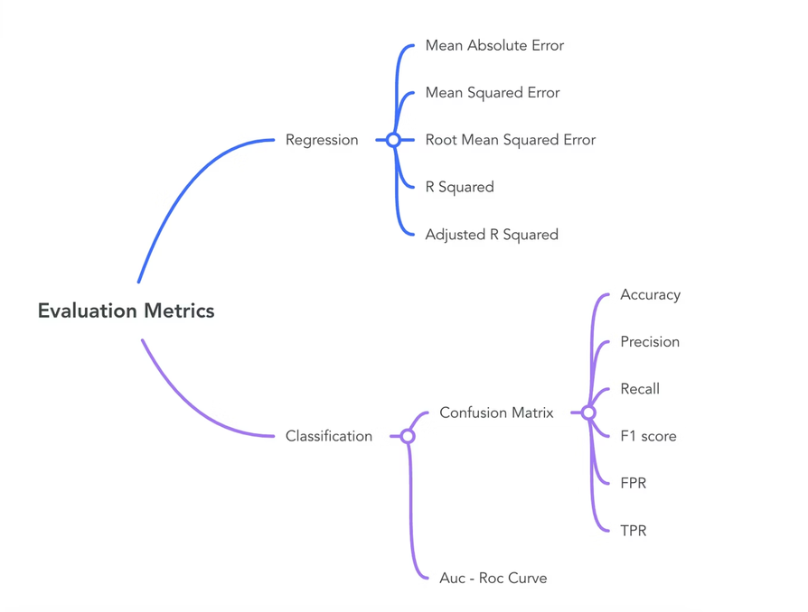
Model Evaluation: Quantifying Performance
After training, we must objectively assess our model's performance. Evaluation metrics provide insights into how accurate our predictions are and where the model might be "wrong."
MAE (Mean Absolute Error)
The average magnitude of the errors in a set of predictions, without considering their direction. It measures the average absolute difference between predicted and actual values, telling us the typical dollar amount our prediction is off by.
MSE (Mean Squared Error)
Measures the average of the squares of the errors. Since errors are squared, larger errors are penalized more heavily. This metric is very sensitive to outliers.
R² Score (Coefficient of Determination)
Represents the proportion of the variance in the dependent variable that is predictable from the independent variables. A value of 1.0 indicates a perfect fit, while 0.0 suggests the model explains none of the variance. Our goal is to achieve an R² as close to 1.0 as possible.

Slide 13
R² Score: Quantifying Model Explanatory Power
The R² (R-squared) score is a key metric in regression analysis, providing a statistical measure of how well the regression predictions approximate the real data points. It essentially represents the proportion of variance in the dependent variable that can be predicted from the independent variables.
Understanding the R² Value
Communicating Model Accuracy
The R² score indicates how much of the variation in our target variable (used car price) is explained by our model's features. For example, an R² of 0.89 signifies that our model can account for 89% of the fluctuations in car prices based on the input features. The remaining variance is unexplained.
This metric is critical for communicating model performance to stakeholders. A higher R² (closer to 1.0) implies a better fit and more reliable predictions. We translate this score into a clear percentage to convey the model's predictive strength, such as "Our model predicts car prices with 89% accuracy based on the available features."

Slide 14
From Raw Data to Actionable Intelligence
What began as a simple pricing question became a complete machine learning journey: we defined the problem, prepared and explored the data, transformed features into model-ready signals, built a regression model, and evaluated its performance with meaningful metrics. Along the way, we turned scattered used-car records into a repeatable pipeline that produces not just predictions, but insight—showing how data can move from information to intelligence, and from analysis to better decisions.
Problem Framing
Business Impact
We started with a clear objective: predict used-car prices as a continuous regression task with business value.
This model creates practical value by supporting smarter pricing decisions, sharper inventory strategy, and more consistent market positioning. It gives teams a data-backed way to justify price points, identify depreciation drivers, and respond faster to changing market conditions. In short, it replaces guesswork with evidence and turns pricing into a competitive advantage.
Data Preparation
What We Learned
Cleaning, encoding, and structuring the dataset transformed noisy raw records into a reliable foundation for modeling.
Strong ML projects begin with a clearly framed problem and a measurable objective.
Data quality matters as much as model choice; cleaning and encoding shape everything that follows.
Exploration turns raw features into understanding, revealing which signals actually drive outcomes.
Evaluation is not the end—it is the checkpoint that tells us how to improve responsibly.
Exploration & Modeling
EDA revealed the signals that matter most, and the regression workflow converted those patterns into usable predictions.
The Path Forward
Evaluation & Validation
This workflow is a foundation, not a finish line. The next step is to test more advanced models, tune hyperparameters, expand features, and explore deployment in a real-world setting. With continuous improvement, this pipeline can evolve into a reliable decision-support system that grows in accuracy, robustness, and business impact over time.
R², MAE, and RMSE gave us a balanced view of fit and error, confirming where the model performs well and where it can improve.
Data-driven decision making is the real outcome of machine learning. When raw data is transformed with care, curiosity, and rigor, it becomes actionable intelligence—and that is where the true power of the model begins.

